Slide 1
INDUSTRIAL TRAINING

Slide 2
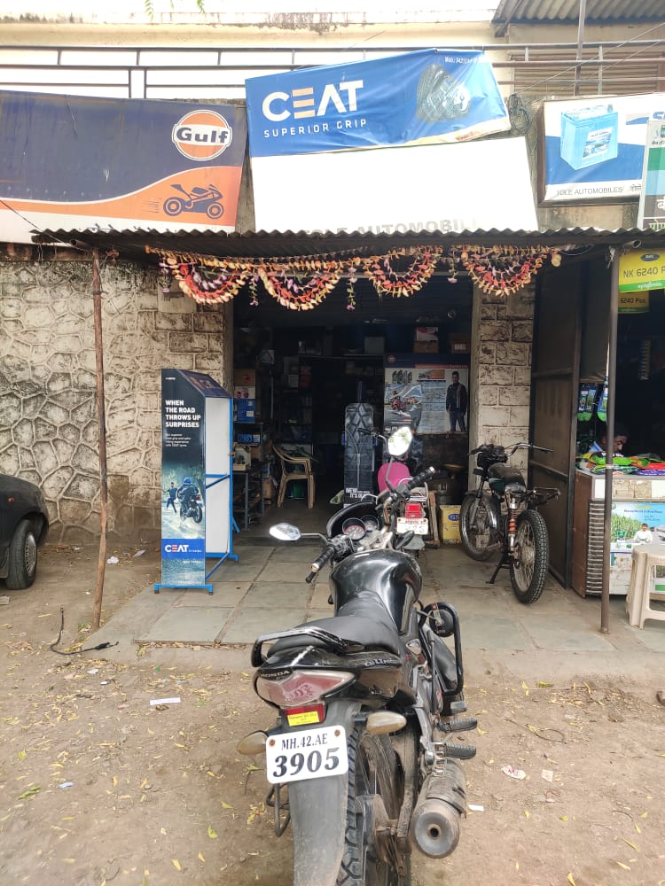
TOLE AUTOMOBILE

Slide 3
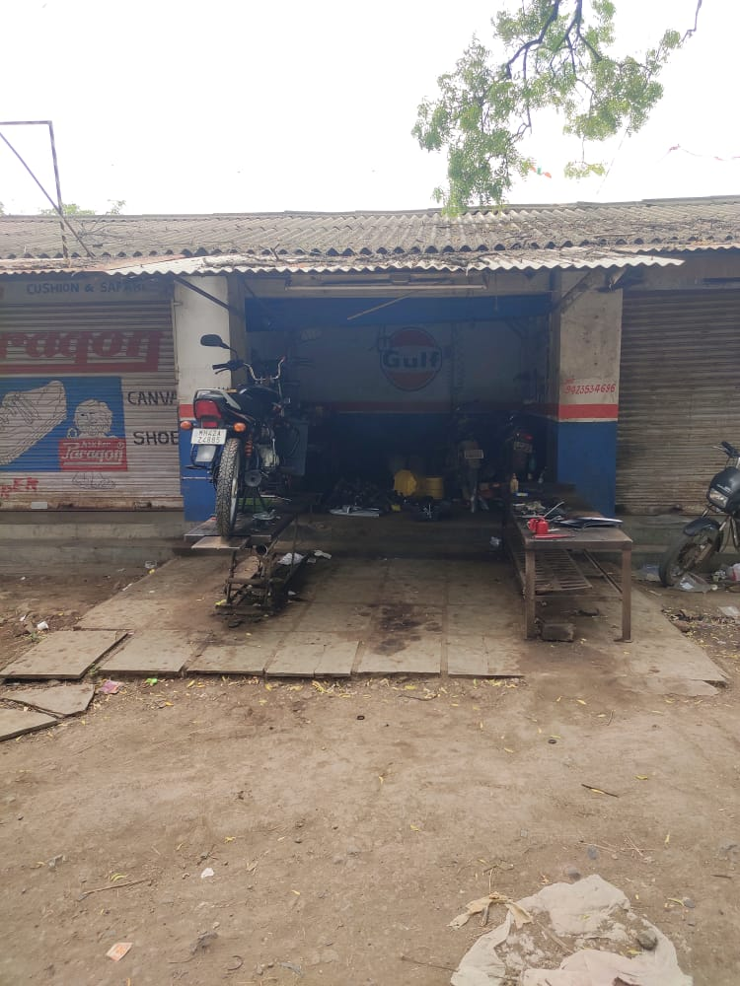
STORE ROOM
WORKSHOP

Slide 4
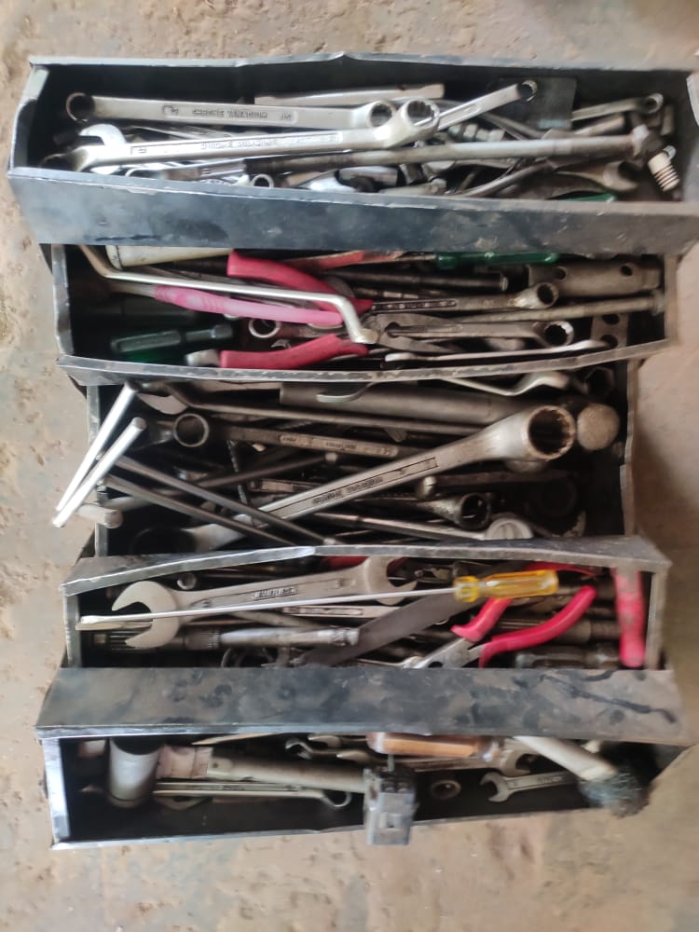
TOOL BOX 🗃
TOOL BOX CONTENT
Screwdrivers. ...
Spanners and Sockets. ...
Hammers. ...
Measuring Tape. ...
Pliers. ...
Utility Knife. ...
Spirit Levels. ...
Torches.

Slide 5
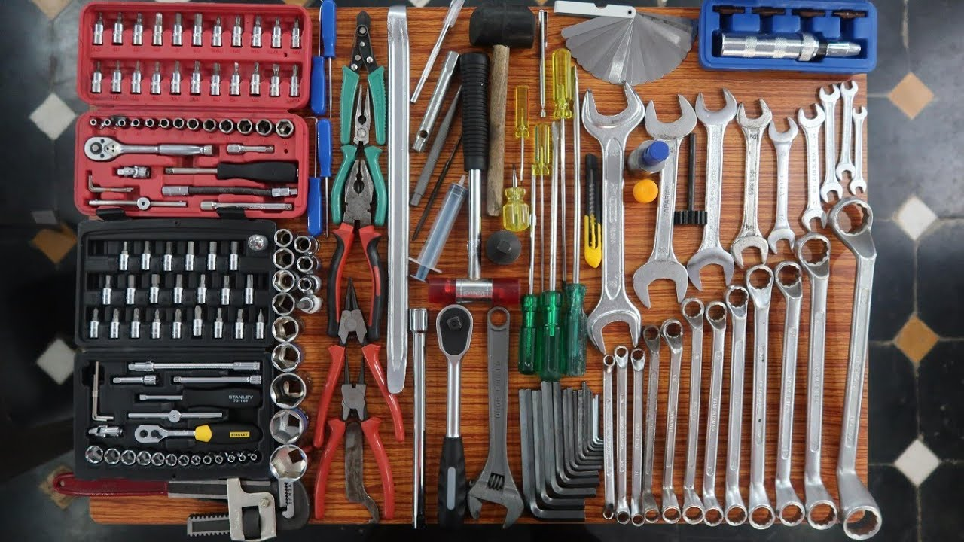

Slide 6
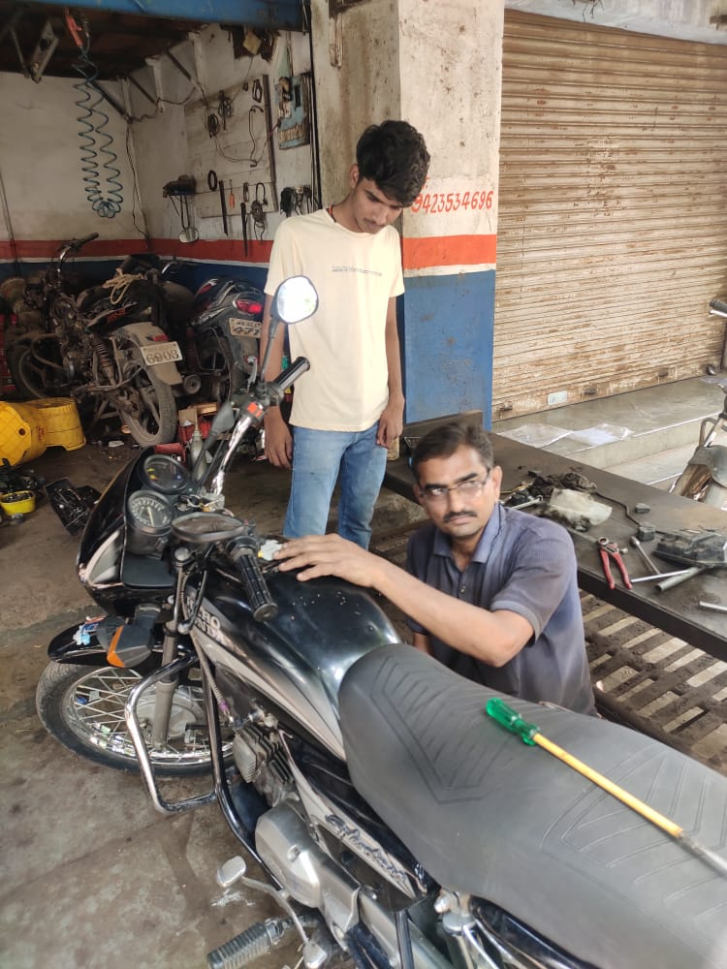
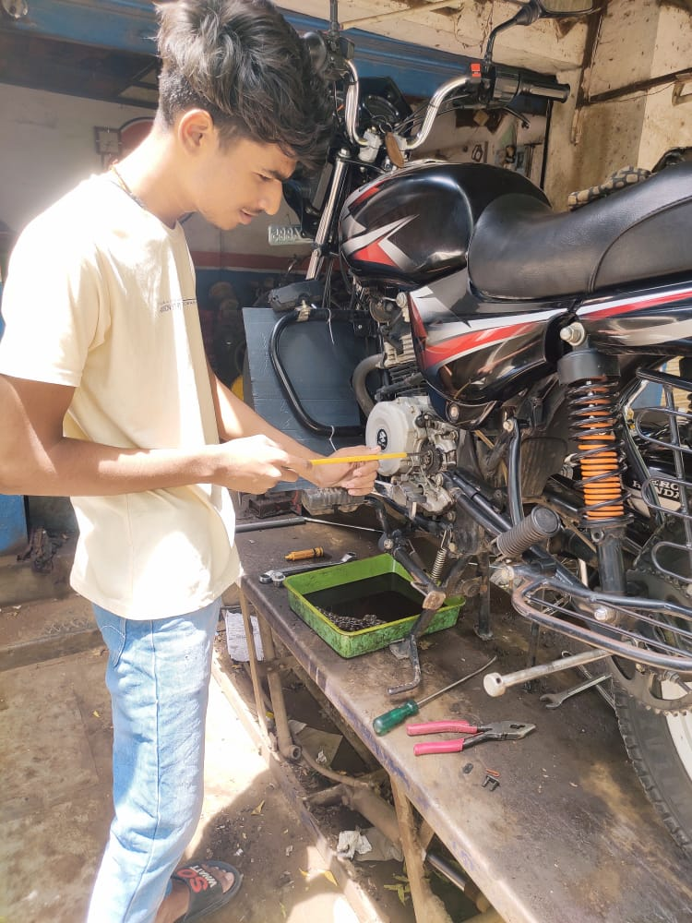
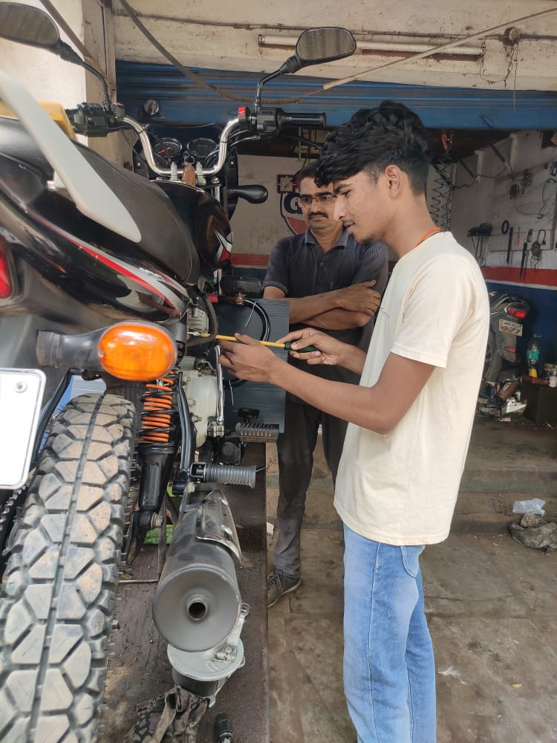
WORK’S IN GARAGE

Slide 7
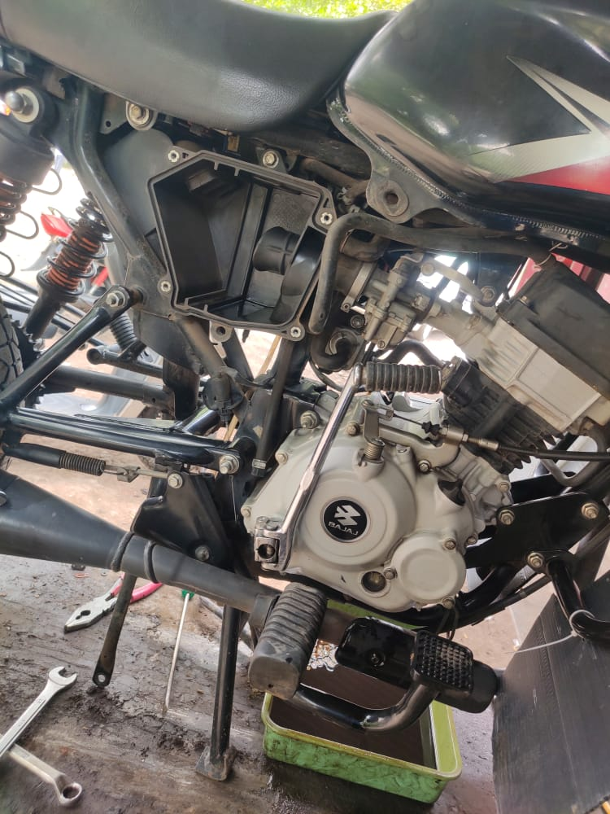
SERVICING THE BIKE

Slide 8
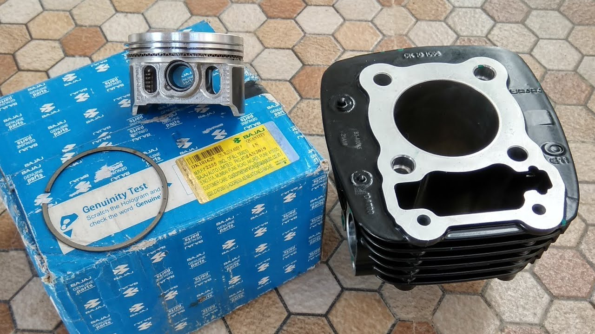
BLOCK PISTON
We all know that our motorbikes have a piston inside the cylinder block of the bike. This piston is what moves and produced the power when fuel is burnt.

Slide 9
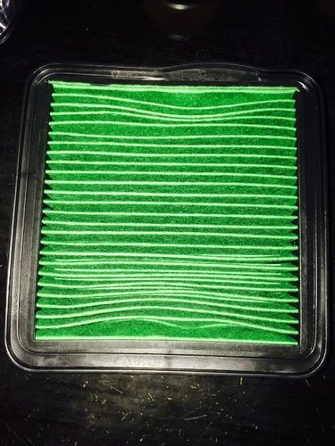
AIR FILTER
What is an air filter? Just as humans need oxygen to breathe, a car needs oxygen for the combustion process. The air filter prevents any insects, dust, particles, sand or debris reaching the engine and ensures a good mixture of air and fuel to support performance.

Slide 10
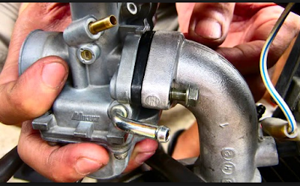
CARBURETOR
A carburetor's job is to supply an internal combustion engine with air/fuel mixture. Carburetors regulate the flow of air through their Main bore (Venturi), this flowing air draws in fuel and the mixture enters the engine via the intake valve.

Slide 11
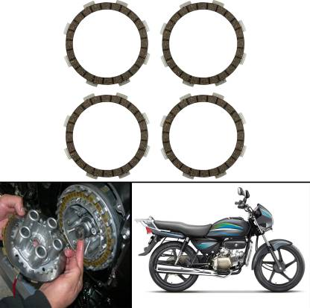
CLUTCH PLATES
a plate in a vehicle's clutch that connects to the transmission.

Slide 12
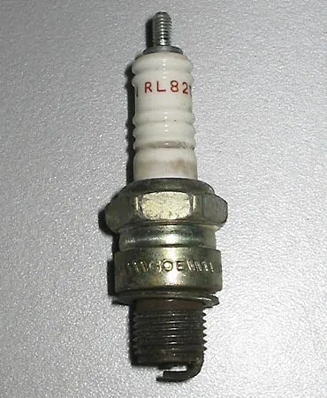
SPARK PLUG
As their name suggests, spark plugs are the spark of electricity that ignites the combustion needed to start your vehicle. Spark plugs emit a bolt of electricity across a small gap igniting the fuel and air mixture that puts the pistons in motion and gets your vehicle up and running.

Slide 13
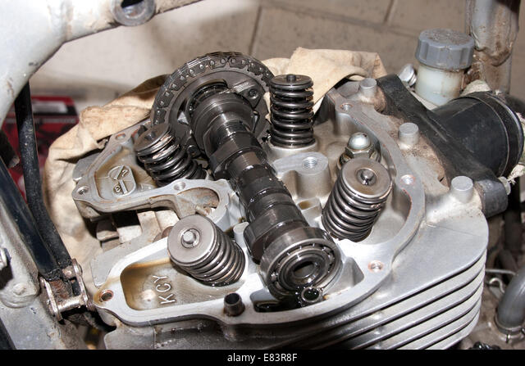
CAMSFAFT
The operation of the valves of the engine is dependent on the camshaft and its lobes as they are the one controlling the opening and closing of the valves along with the timing of it. The camshaft is the one rotating along with the crankshaft that is turning the engine, i.e. the piston moving up and down.

